Slide 1
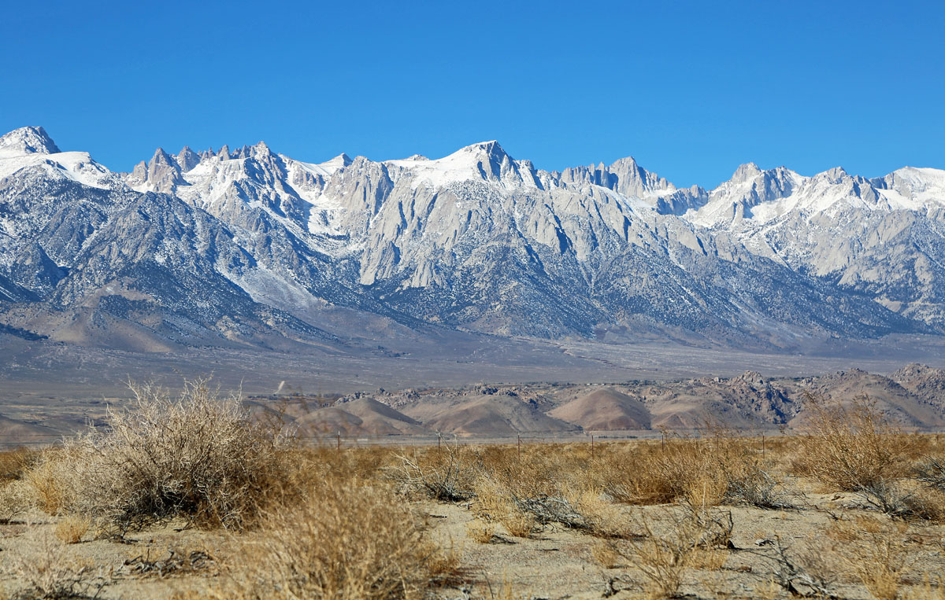
Cenozoic tectonic evolution of the White Mountains, California and Nevada
Daniel F. Stockli

Slide 2
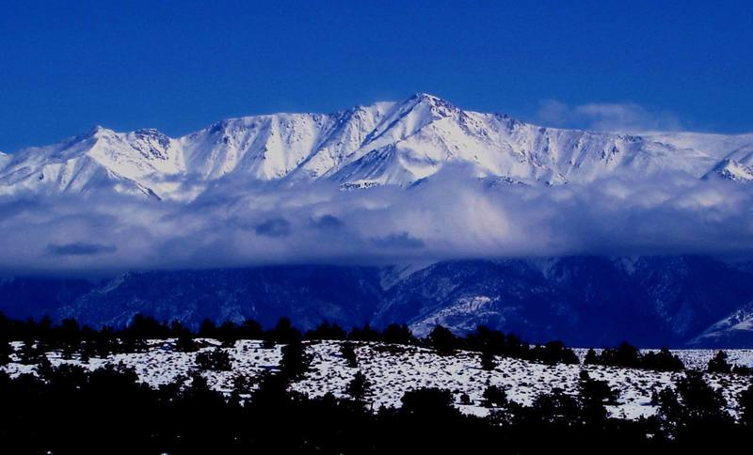
The Big Picture
Today, White mtn peak is the 3rd highest peak in CA (14,252 ft).
Over the past 12 Ma (mainly in the last 3-6 Ma) local tectonics changed dramatically.
~ 12 Ma the White Mountains began exhumation and tilting resulting in ~8 km of uplift.
Stockli shows this by radiomeric (Uranium decay) dating of rock samples along the range and showing tectonic evolution in the region.

Slide 3
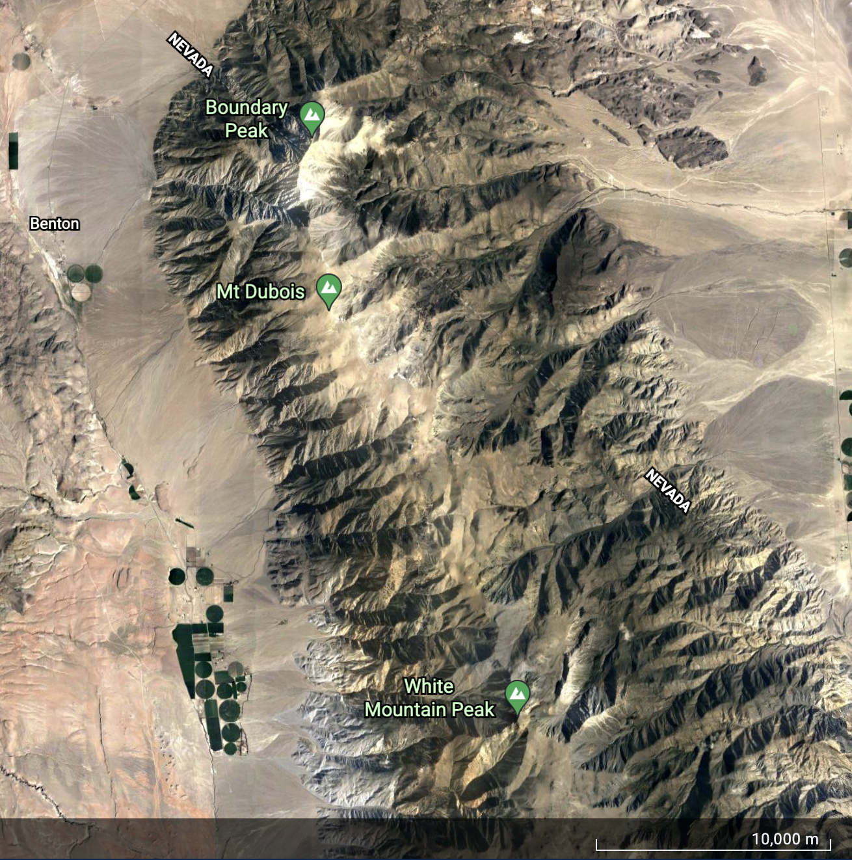
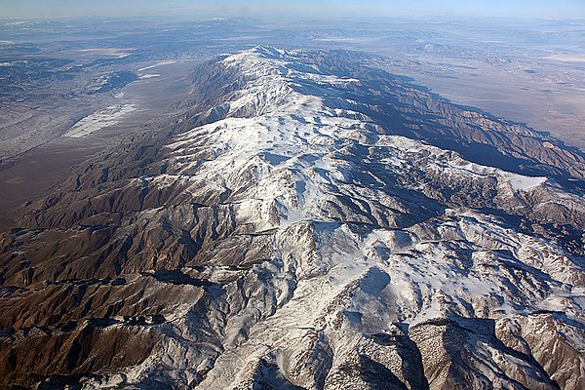

Slide 4
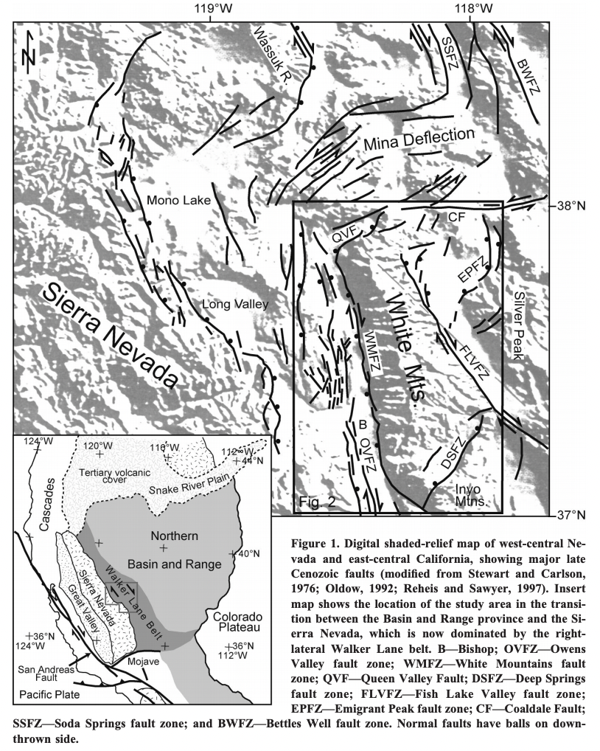
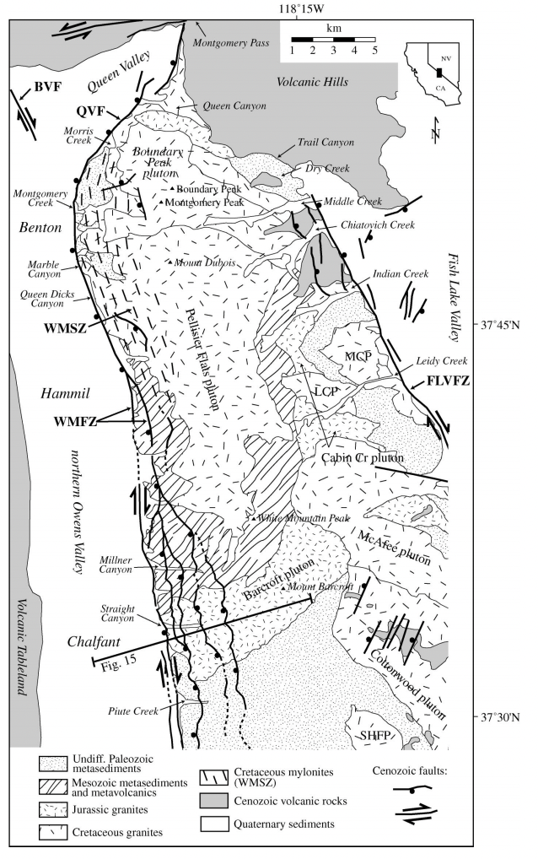
Geologic setting: Key fault zones are the White mountain fault zone (WMFZ) and Fish Lake Valley Fault Zone (FLVFZ).

Slide 5
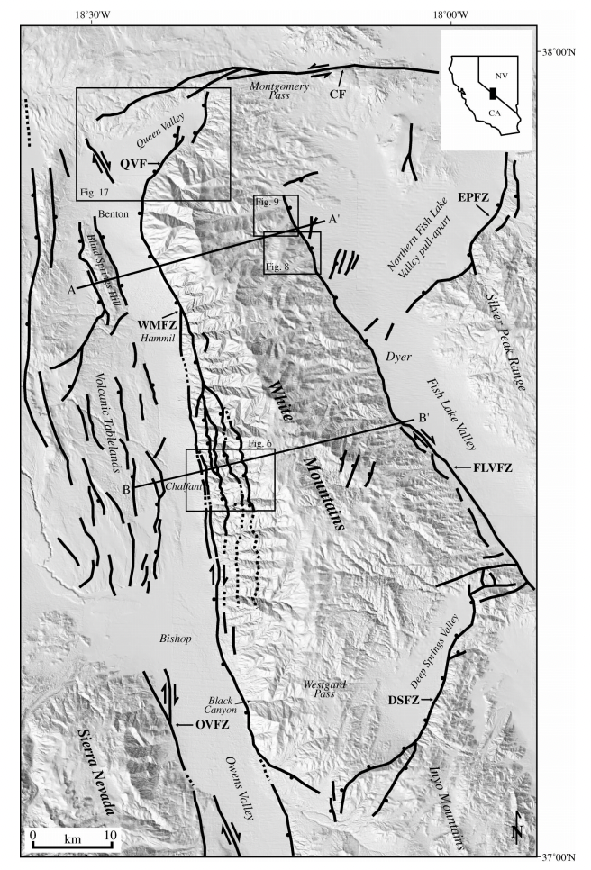
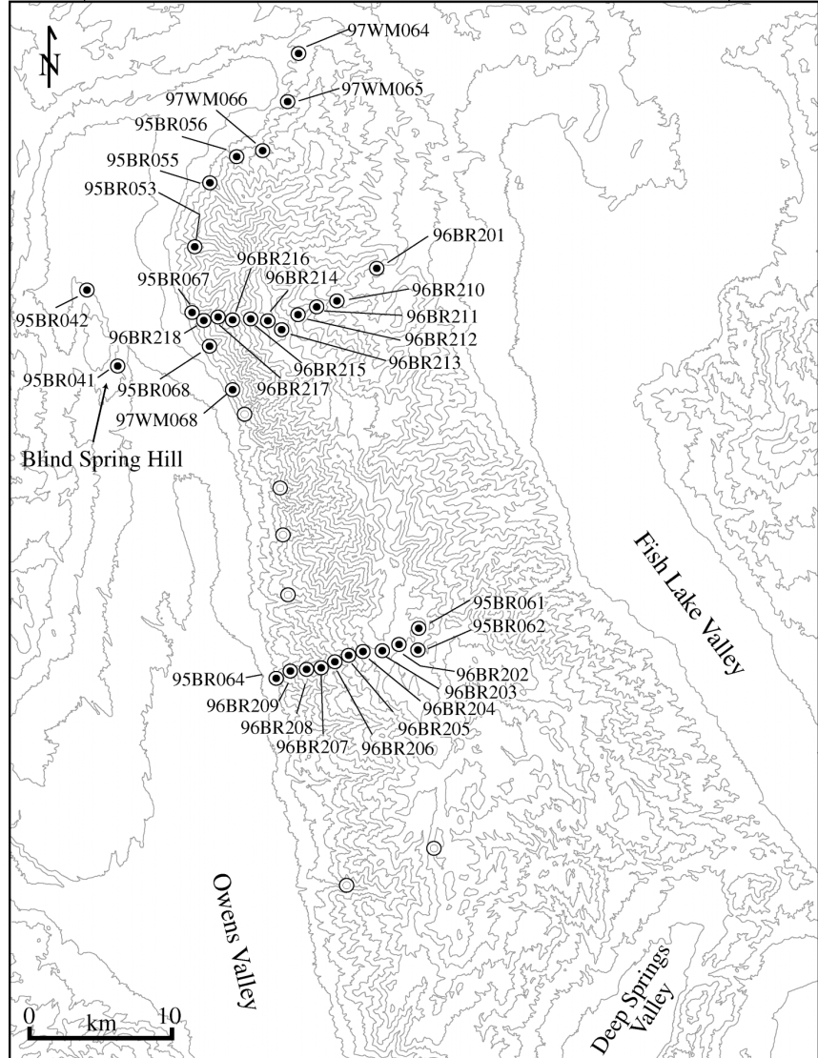
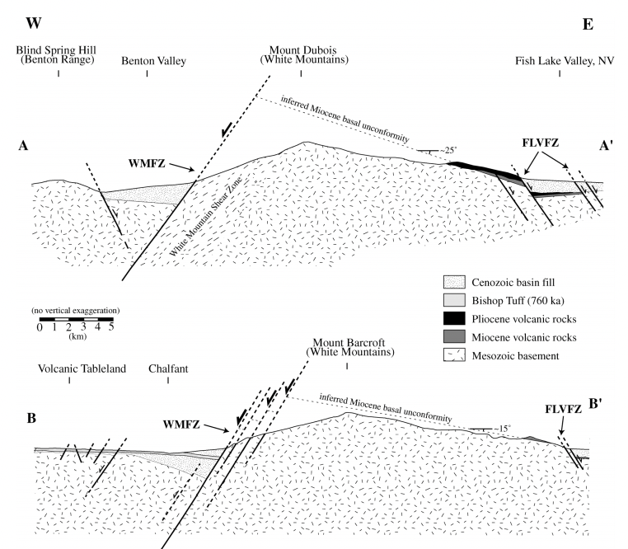
Study rests largely on the collection and dating of rocks along the two transects shown.

Slide 6
Thermo-chronological (U-TH / He dating)
. U238 decays into Lead 206. Helium nuclei (2p&2n) by-product.
. To find the age of a sample, geologists find the ratio of daughter isotopes to remaining parent isotopes present.
. From the known parent isotopes and the decay constant, we can then determine the age.

Slide 7
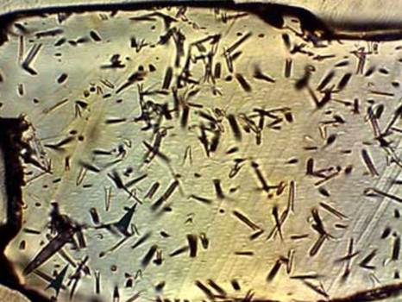
Apatite fission track dating
. (U-Th)/He dating is used to measure the age of a sample by measuring the amount of radiogenic helium (4He) present as a result of the alpha decay from uranium and thorium.
. When nuclear fission of uranium-238 (238U) happens in organic materials, damage tracks are created.

Slide 8
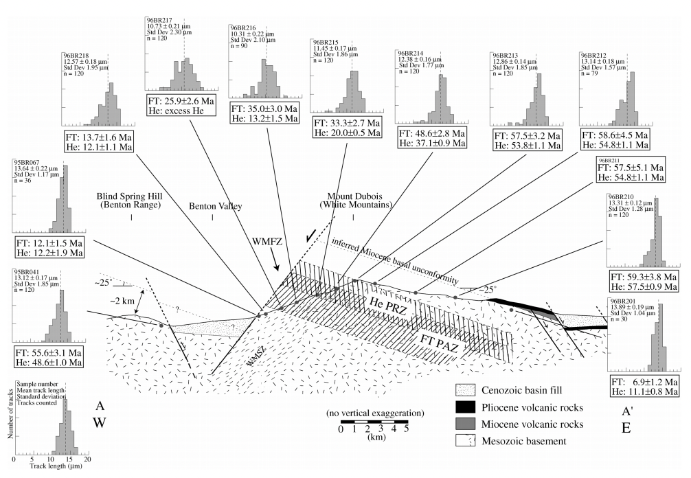
. Stockli preformed thermo-chronological (U-TH / He dating) and apatite fission track dating for multiple E-W transects.
. Transect of samples across range allows sampling of rocks at different depths- assuming tilting of range during uplift - the samples will be from different depths and record ‘cooling ages’.
Assumption of tilting based on observation that Plio-Miocene volcanic flows horizontal when formed and underlying.

Slide 9
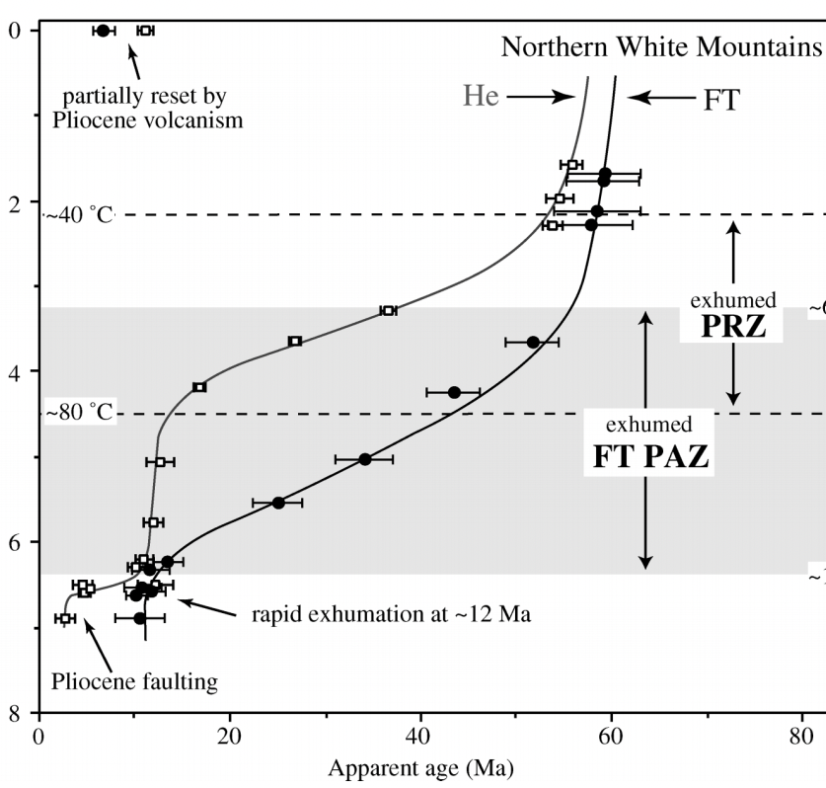
Original placement and cooling.
Rocks cooling but little change.
Rocks of very different structural depth shoe same ages.
Concordant fission-track and (U-Th)/He ages and invariant cooling ages below the base of the PAZ and PRZ indicate rapid cooling and exhumation of the White Mountains starting at ca. 12 Ma.

Slide 10
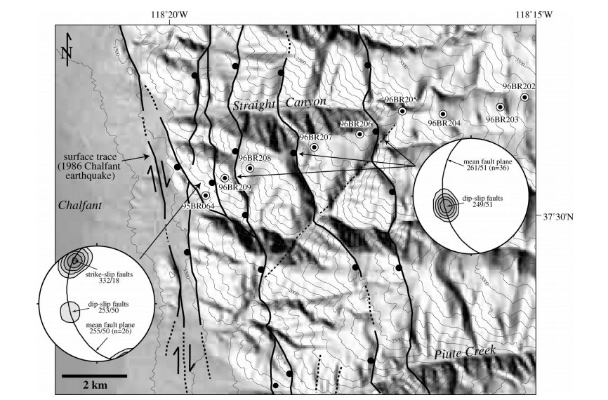
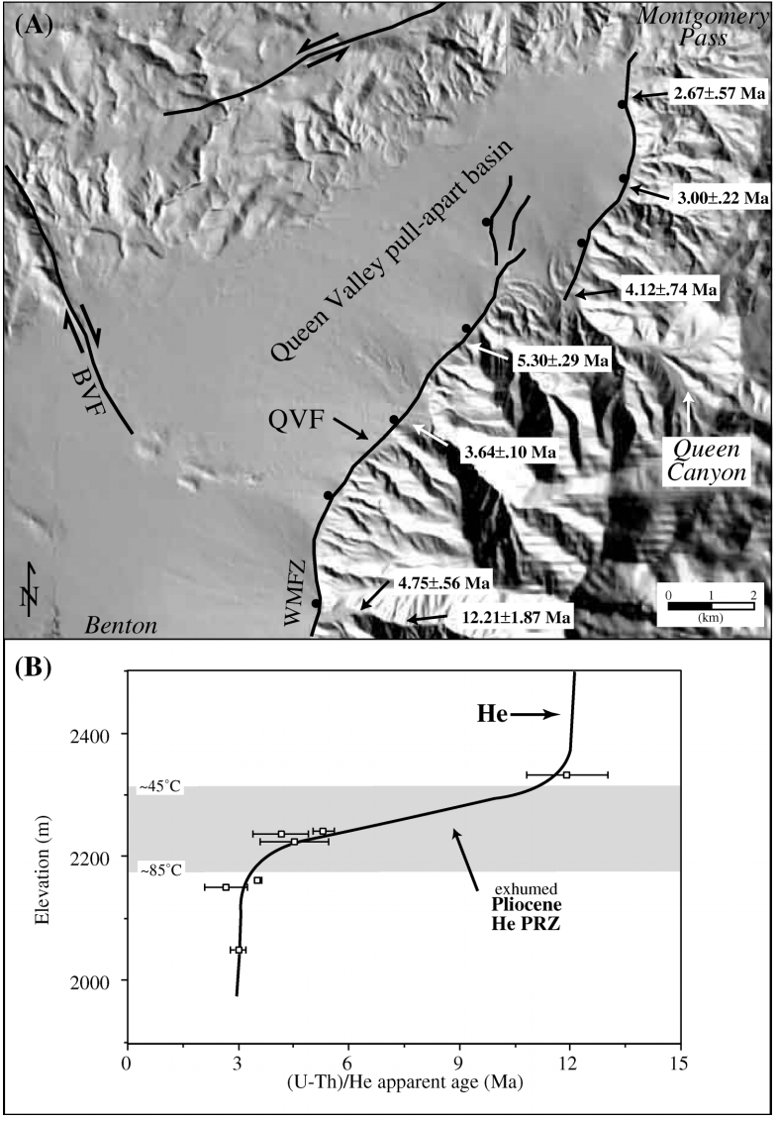
. Faults along range were once only dip-slip motion.
. Observation: dip-slip striae are overprinted by strike-slip striae.
. Interpretation: the most recent uplift observed in cooling age profile and north end of range is due to transition to strike-slip displacement.

Slide 11
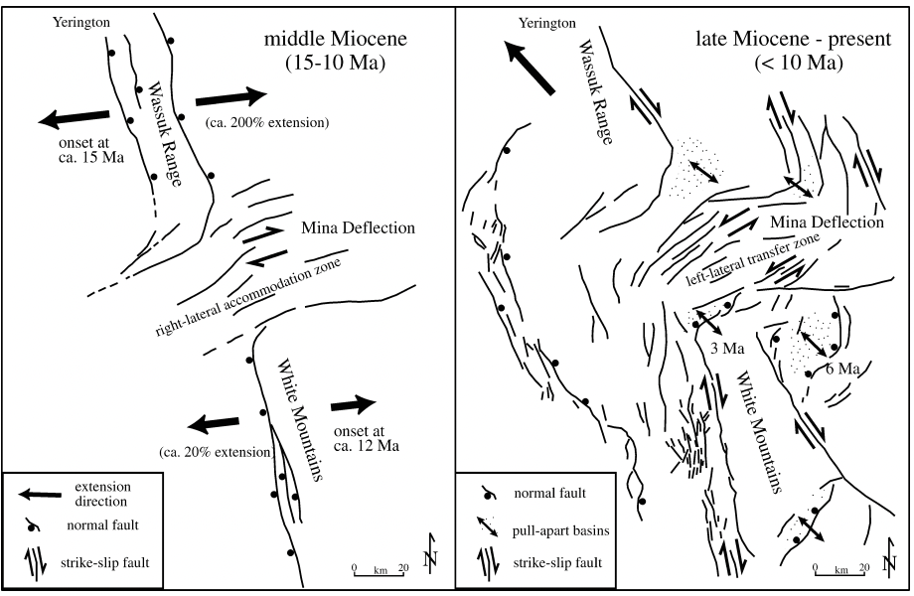
. The middle miocene was characterized by dominant east-west extension and normal faulting.
. ~10-6 Ma, central western Basin and Range started to undergo transtentional deformation as a result of NW-SE extension.

Slide 12
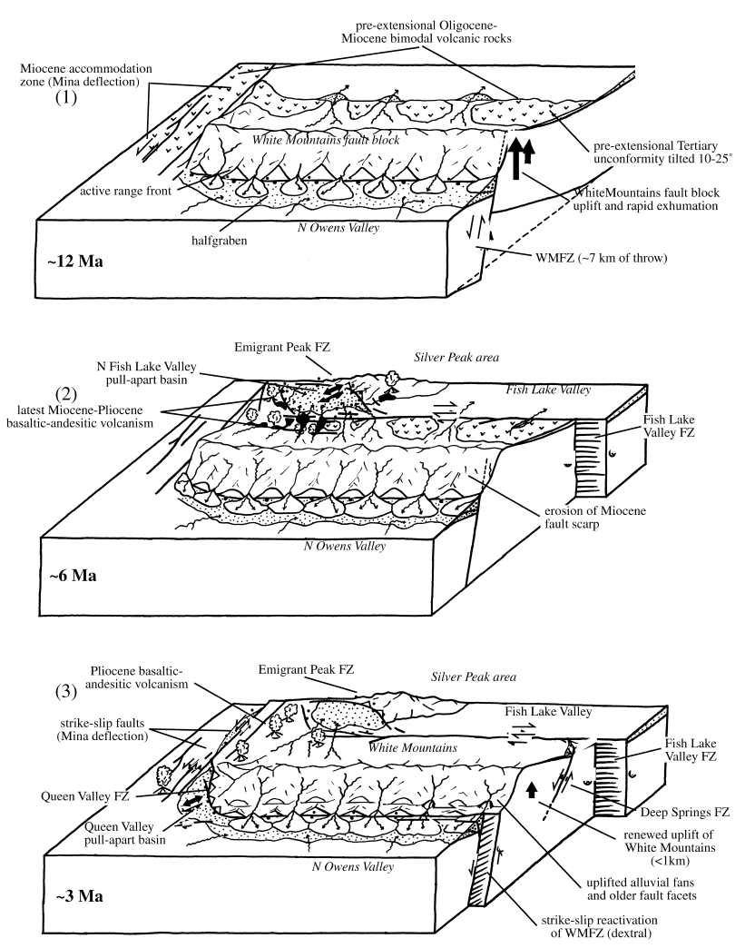
East-west extension resulting in eastward tilting & uplift ~12 Ma
Inception of strike slip faulting ~6 Ma in the fish lake valley area and formation of pull-apart basin.
Right lateral strike slip began to occur ~3 Ma.

Slide 13
The Big Picture
Over the past 12 Ma (mainly in the last 3-6 Ma) local tectonics changed dramatically.
~ 12 Ma the White Mountains began exhumation and tilting resulting in ~8 km of uplift.
Stockli shows this by radiomeric (Uranium decay) dating of rock samples along the range and showing tectonic evolution in the region.

